Slide 1
Chapter 4
Internet Consumers,
E-Service, and
Market Research
Prentice Hall, 2002

Slide 2
Learning Objectives
Describe the essentials of consumer behavior
Describe the characteristics of Internet surfers and EC purchasers
Understand the decision-making process of consumer purchasing
Describe the way companies are building relationships with customers
Prentice Hall, 2002

Slide 3
Learning Objectives (cont.)
Explain the implementation of customer service and its relationship with CRM
Describe consumer market research in EC
Understand the role of intelligent agents in consumer applications
Describe the organizational buyer behavior model
Prentice Hall, 2002

Slide 4
Opening Vignette:
Building Customer Relationships: Ritchey Design, Inc.
Ritchey Design, Inc.
  Small business designing and manufacturing mountain bike components
  1995 Web site was a status symbol rather than a business tool
  The site did not:
    Offer enough customer information
    Enable the company to gain insight into their customers’ needs and wants
Prentice Hall, 2002

Slide 5
Building Customer Relationships:
Ritchey Design, Inc. (cont.)
The static Web site becomes an interactive marketing tool
  The company cut a deal with SBT software for Web Trader
    A software package that allows companies to sell products over the Internet
    It also collects information from customers
  Ritchey’s Design Inc. obtained a low price for the software by:
    Testing the package for SBT
    Putting the SBT logo on their site
Prentice Hall, 2002

Slide 6
Building Customer Relationships:
Ritchey Design, Inc. (cont.)
Customer surveys introduced the site
  Induced customers to complete surveys by offering opportunity to win Ritchey products
    Web Trader automatically saves and organizes answers in the database
    Information used to make marketing decisions
  Created an electronic product catalog
    Consumers find detailed descriptions and pictures of products
    Dealers can obtain information and order over the Web
Prentice Hall, 2002

Slide 7
Netflix.com
Wold largest online movie rental
5.2 m subscriber
6500 titles – 200 categories
42 m DVD
Distribute 1m DVD per day
Strong competition with neighbourhoods, blockbuster, Wal-Mart and online rentals
Prentice Hall, 2002

Slide 8
Netflix.com
Cinematch Software
Datamining of 1 Billion film ratings
Customer history like amazon.com
Also subscriber recommendation
1 m$ prize - improvement in accuracy by 10%
Use almost all online techniques – emial, blogs, social network, etc.
Prentice Hall, 2002

Slide 9
Netflix.com RESULT
7O% of Movies based on CineMatch
Customer loyalty n satisfaction improve by 90%
80% rental activity from 2000 titles
Get 2m ratings form from subscriber
Membership growth from 600,000 to 5 million
Prentice Hall, 2002

Slide 10
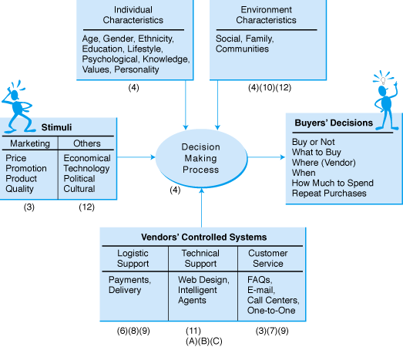
Figure 4-1
EC Consumer Behavior Model
Source: Zinezone, c/o GMCI Co.
Prentice Hall, 2002

Slide 11
Consumer Behavior Online (cont.)
Consumer types
  Individual consumers
    Commands most of the media’s attention
Organizational buyers
  Governments and public organizations
  Private corporations
  Resellers
  Consumer behavior viewed in terms of:
    Why is the consumer shopping?
    How does the consumer benefit from shopping online?
Prentice Hall, 2002

Slide 12
Consumer Behavior Online (cont.)
Purchasing types and experiences
  2 dimensions of shopping experiences
    Utilitarian—to achieve a goal
    Hedonic—because it’s fun
  3 categories of consumers
    Impulsive buyers—purchase quickly
    Patient buyers—make some comparisons first
    Analytical buyers—do substantial research before buying
Prentice Hall, 2002

Slide 13
Consumer Behavior Online (cont.)
Direct sales, intermediation, and customer relations
  Companies that sell only through intermediaries still need good relations with the end-users
  Example: Ford Motor Company
    Do not sell directly to consumers
    Recognize that drivers of Ford vehicles think of themselves as having a relationship with the company
Prentice Hall, 2002

Slide 14
Personal Characteristics and Demographics of Internet Surfers
Environmental variables
  Social variables
  Cultural variables
  Psychological variables
  Other environmental variables
Prentice Hall, 2002

Slide 15
Personal Characteristics of Internet Surfers
Personal characteristics and differences
  Consumer resources and lifestyle
  Age and gender
  Knowledge and educational level
  Attitudes and values
  Motivation
  Personality
Prentice Hall, 2002

Slide 16
Demographics of Internet Surfers
Major demographics presented include
  Gender
  Age
  Marital status
  Educational level
  Ethnicity
  Occupation
  Household income
Prentice Hall, 2002

Slide 17
Demographics of Internet Surfers (cont.)
The more experience people have on the Web, the more likely they are to buy online
Two major reasons people do not buy online
  Security
  Difficulty judging the quality of the product
Prentice Hall, 2002

Slide 18
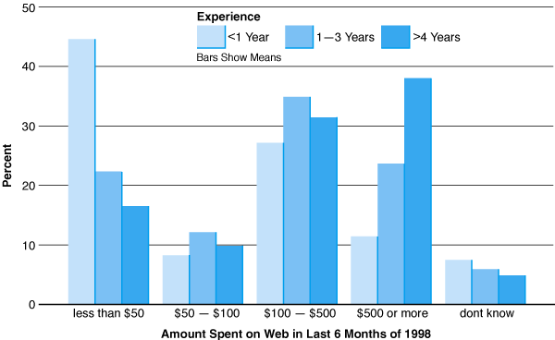
Figure 4-2
Amount of Money Spent on the Web
Prentice Hall, 2002

Slide 19
Consumer Purchasing Decision Making
Roles people play in decision-making
  Initiator—suggests/thinks of buying a particular product or service
  Influencer—advice/views carry weight in making a final buying decision
  Decider--makes a buying decision or any part of it
  Buyer—makes the actual purchase
  User—consumes or uses a product or service
Prentice Hall, 2002

Slide 20
Consumer Purchasing
Decision Making (cont.)
Purchasing decision-making model
  5 major phases of a general model
    Need identification—actual and desired states of need
    Information search
    Alternatives evaluation—research reduces number of alternatives, may lead to negotiation
    Purchase and delivery—arrange payment, delivery, warranties, etc.
    After-purchase evaluation—customer service
Prentice Hall, 2002

Slide 21
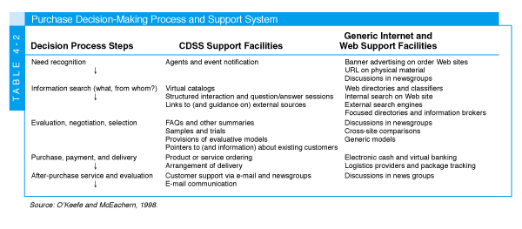
Table 4-2
Purchase Decision Making Process & Support System consumer decision support system (CDSS)
Source: O’Keefe and McEachern, 1998.
Prentice Hall, 2002

Slide 22
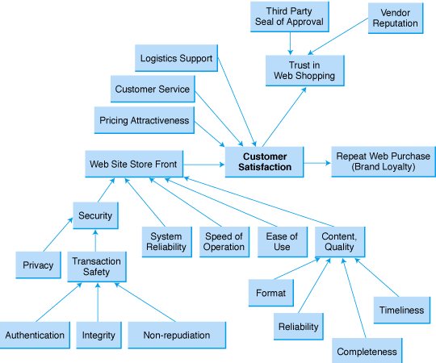
Figure 4-3
Model of Internet Consumer Satisfaction
Source: Lee (2001)
Prentice Hall, 2002

Slide 23
Matching Products with
Customers: Personalization
One-to-one marketing
  Relationship marketing
    “Overt attempt of exchange partners to build a long term association, characterized by purposeful cooperation and mutual dependence on the development of social, as well as structural, bonds”
  “Treat different customers differently”
    No two customers are alike
Prentice Hall, 2002

Slide 24
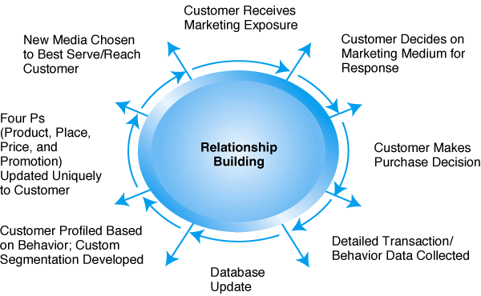
Figure 4-4
The New Marketing Model
Source: GartnerGroup
Prentice Hall, 2002

Slide 25
Matching Products with
Customers: Personalization (cont.)
Issues in EC-based one-to-one marketing
  Customer loyalty—degree to which customer stays with vendor or brand
    Important element in consumer purchasing behavior
    One of the most significant contributors to profitability
      Increase profits
      Strengthen market position
      Become less sensitive to price competition
      Increase cross-selling success
      Save costs, etc.
Prentice Hall, 2002

Slide 26
Matching Products with
Customers: Personalization (cont.)
Issues in EC-based one-to-one marketing
  Meeting customers cognitive needs—organize customer service to meet needs of each skill set
    Novice
    Intermediate
    Expert
  E-loyalty—customer’s loyalty to an e-tailer
    Learn about customers’ needs
    Interact with customers
    Provide customer service
Prentice Hall, 2002

Slide 27
Matching Products with
Customers: Personalization (cont.)
Issues in EC-based one-to-one marketing
  Trust in EC
    Deterrence-based trust—threat of punishment
    Knowledge-based trust—grounded in knowledge about trading partners
    Identification-based trust—empathy and common values between partners
  Value of EC referrals
    Word-of-mouth
    Delivery of good or service sparks other users
Prentice Hall, 2002

Slide 28
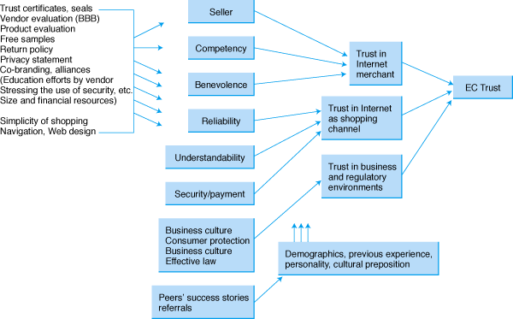
Figure 4-5
The EC Trust Model
Source: Lee and Turban (2001)
Prentice Hall, 2002

Slide 29
Matching Products with
Customers: Personalization (cont.)
Personalization
  Process of matching content, services, or products to individuals’ preferences
  Alternative methods
    Solicit information from users
    Use cookies to observe online behavior
    Use data or Web mining
  Personalization applied through
    Rule-based filtering
    Content-based filtering
    Constraint-based filtering
    Learning-agent technology
Prentice Hall, 2002

Slide 30
Matching Products with
Customers: Personalization (cont.)
Personalization (cont.)
  Collaborative filtering examples
    Backfilp.com—recommends restaurants
    C5solutions.com—personalized messages via cell phones
    Mysimon.com—assists in purchase decision-making process based on user information
  Legal and ethical issues
    Privacy issues
    Permission-based personalization tools
Prentice Hall, 2002

Slide 31
Delivering Customer Service in Cyberspace
Customer service
  Traditional: do the work for the customer
  EC delivered: gives tools to the customer to do the work for him/herself (log: tracking, troubleshooting, FAQ) with
    Improved communication
    Automated process
    Speedier resolution of problems
Prentice Hall, 2002

Slide 32
Delivering Customer Service in Cyberspace (cont.)
E-service—online help for online transactions
  Foundation of service—responsible and effective order fulfillment
  Customer-centered services—order tracing, configuration, customization, security/trust
  Value-added services--dynamic brokering, online auctions, online training and education
Prentice Hall, 2002

Slide 33
Delivering Customer Service in Cyberspace (cont.)
Product life cycle and customer service
  Phases of product life cycle
    Requirements: assisting the customer to determine needs
    Acquisition: helping the customer to acquire a product or service
    Ownership: supporting the customer on an ongoing basis
    Retirement: helping the client to dispose of a service or product
    Service must be provided in all of them
Prentice Hall, 2002

Slide 34
Delivering Customer Service in Cyberspace (cont.)
Customer relationship management (CRM)
  CRM in action—customer-focused EC
    Make it easy for customers to do business online
    Business processes redesigned from customer’s point of view
    Design a comprehensive, evolving EC architecture
    Foster customer loyalty by:
      Personalized service
      Streamline business processes
      Own customer’s total experience
Prentice Hall, 2002

Slide 35
Customer Relationship Management (CRM)
Customer service functions
  Provide search and comparison capabilities
  Provide free products and services
  Provide specialized information and services
  Allow customers to order customized products and services
  Enable customers to track accounts or order status
Prentice Hall, 2002

Slide 36
Customer Relationship Management (CRM) (cont.)
Customer service tools
  Personalized Web pages
    Used to record purchases and preference
    Direct customized information to customers efficiently
  FAQs
    Customers find answers quickly
    Not customized, no personalized feeling and no contribution to relationship marketing
Prentice Hall, 2002

Slide 37
Customer Relationship Management (CRM) (cont.)
  Tracking tools
    Customers track their orders saving time and money for all
    Example: FedEx’s package tracking
Customer service tools (cont.)
  Chat rooms—discuss issues with company experts and with other customers
  E-mail and automated response
    Disseminate general information
    Send specific product information
    Conduct correspondence regarding any topic (mostly inquiries from customers)
Prentice Hall, 2002

Slide 38
Customer Relationship Management (CRM) (cont.)
Customer service tools (cont.)
  Help desks and call centers
    A comprehensive customer service entity
    EC vendors take care of customer service issues communicated through various contact channels
      Telewebs combine
        Web channels (automated e-mail reply)
        Web knowledge bases (portal-like self service)
        Call center agents or field service personnel
  Troubleshooting tools—assist customers in solving their own problems
Prentice Hall, 2002

Slide 39
Customer Relationship Management (CRM) (cont.)
Justifying customer service and CRM programs—2 problems
  Most of the benefits are intangible
  Substantial benefits reaped only from loyal customers, after several years
  Metrics—standards to determine appropriate level of customer support
    Response and download times
    Up-to-date site and availability of relevant content
    Others
Prentice Hall, 2002

Slide 40
Customer Relationship Management (CRM) (cont.)
  Examples of superb customer service
1-800-FLOWERS
  Buy by telephone, retail shops, and online
  Online and offline promotions
  E-mail order confirmation
Blackstar (music retailer)
  Thanks customers by e-mail
  Provides toll-free telephone number
  Provides tracking system
Amazon.com
  Convenience, selection, value, special services
  E-mail order confirmation
  Personalized services
Federal Express (FedEx)
  Package tracking service
  Ability to calculate delivery costs, online shipping forms, arrange pickup, find local drop box
Prentice Hall, 2002

Slide 41
Market Research for EC
Aim– find relationship between
  Consumers
  Products
  Marketing methods
  Marketers through information
In order to improve customer service
  Discover marketing opportunities and issues
  Establish marketing plans
  Better understand the purchasing process
  Evaluate marketing performance
Prentice Hall, 2002

Slide 42
Figure 4-6
Market Research Process
Market segmentation—divide consumer market into groups to conduct marketing research, advertising, sales
Prentice Hall, 2002

Slide 43
Market Research for EC (cont.)
Conducting online market research—powerful tool for research regarding:
  Consumer behavior
  Discover of new markets
  Consumer interest in new products
Internet-based market research
  Interactive—allowing personal contact
  Gives better understanding of customer, market, and competition
Prentice Hall, 2002

Slide 44
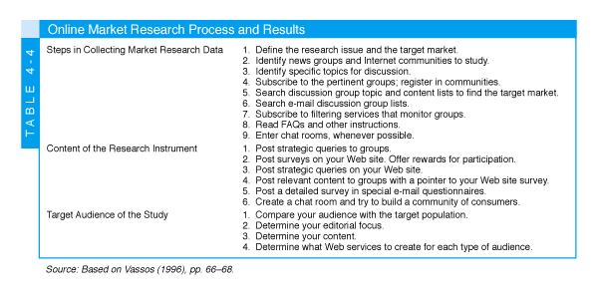
Table 4-4
Online Market Research Process & Results
Online market research methods—fast, cheap, data collection
Source: Based on Vassos (1996), pp. 66-68.
Prentice Hall, 2002

Slide 45
Market Research for EC (cont.)
Online market research methods (cont.)
  Conducting Web-based surveys
  Limitations of online research
    Not suitable for every customer or product
    Skewed toward highly educated males with high disposable income
  May be unreliable, biased
  More knowledge is needed
Prentice Hall, 2002

Slide 46
Market Research for EC (cont.)
Online market research methods (cont.)
  Data mining—searching for valuable business information in extremely large databases
  New business opportunities generated by conducting:
    Automated prediction of trends and behaviors
    Automated discovery of previously unknown patterns and relationships
  Web mining—mining meaningful patterns from Web resources
Prentice Hall, 2002

Slide 47
Market Research for EC (cont.)
Datamining (cont.)
  Major characteristics and objectives of data mining:
    Relevant data difficult to find in huge databases
    Tools help find information buried in corporate files or public records
    “Miner” uses “data drills” for easy access to answers, may find valuable, unexpected results
    Tools combined with spreadsheets for easy analysis of results
    Yields: associations, sequences, classifications, clusters, forecasting
Prentice Hall, 2002

Slide 48
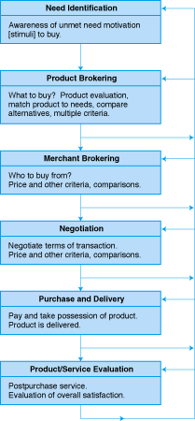
Figure 4-7
A Framework for Classifying EC Agents
The purchasing decision- making process: agent classification
Prentice Hall, 2002

Slide 49
Intelligent Agents in
Customer-related Applications (cont.)
Need identification—helps determine what to buy to satisfy a specific need by looking for specific products information and critically evaluating them
Examples:
  Salesmountain.com—specifically requested items for individual customers
  Discogs.com—sample and buy music
  Netcactus.com—help choose gifts
  Querybot.com/shopping—looks for deals and finds related information on requested items
Prentice Hall, 2002

Slide 50
Intelligent Agents in
Customer-related Applications (cont.)
Product brokering
  Example: Firefly
    Used a collaborative filtering process that could be described as “word-of-mouth” to build the profile
    Asked a consumer to rate a number of products
    Matched his ratings with the ratings of other consumers
    Relied on the ratings of other consumers with similar tastes, recommended products that he has not yet rated
Prentice Hall, 2002

Slide 51
Intelligent Agents in
Customer-related Applications (cont.)
Merchant brokering—intelligent agents for finding vendors
  Bargainfinder from Andersen Consulting (first product brokering agent—no longer exists)
    Queried the price of a specific CD from a number of online vendors and returned a list of prices (unsuccessful)
  Jango (embedded in excite program)
    Originates the requests from the user’s site instead of from Jango’s ⇒ vendors have no way to determine whether the request is from a real customer or from the agent
    Provides product reviews
Prentice Hall, 2002

Slide 52
Intelligent Agents in
Customer-related Applications (cont.)
Merchant brokering (cont.)
  Kasbah from MIT Lab (product & services comparison agent)—no longer operating
    Users wanting to sell or to buy a product, assign the task to an agent who is then sent out to proactively seek buyers or sellers
Purchase and delivery—arrange payment and delivery of goods
After sale service and evaluation—automatic answering agents respond to customer queries and remind them of maintenance needs
Prentice Hall, 2002

Slide 53
Intelligent Agents in
Customer-related Applications (cont.)
Negotiation—price and other terms of transactions are determined
  Kasbah
    Multiple agents—users create agents for the purpose of selling or buying goods
    3 strategies: anxious, cool-headed and frugal
  Tete-@-tete (no longer in operation)
    Parameters: price, warranty, delivery time, service contracts, return policy, loan option and other value added services
    Use information acquired during the first two stages of the purchasing decision model to evaluate each single offer
Prentice Hall, 2002

Slide 54
Intelligent Agents in
Customer-related Applications (cont.)
Other EC agents
  Auction support agents
  Fraud and detection protection agents
  Character-based interactive (animated) agents
  Learning agent
Prentice Hall, 2002

Slide 55
Intelligent Agents in
Customer-related Applications (cont.)
Organizational buyer behavior
  Purchase same products as individuals
  Transaction volumes much larger
  Terms of negotiations and purchasing more complex
  Purchasing process more important than to an individual buyer
Behavioral model of organizational buyers
  Influencing variables different from those of individual buyers
  Organization purchasing guidelines and constraints
  Interpersonal influences are factors (authority)
  Group decision making
Prentice Hall, 2002

Slide 56
Management Issues
Understanding consumers
Consumers and technology
Response time
Intelligent agents
Market research
CRM and EC integration
Measuring customers’ satisfaction from a Web site
Prentice Hall, 2002

